Slide 1






Meet the Teacher
Wednesday 18th September 2024

Slide 2
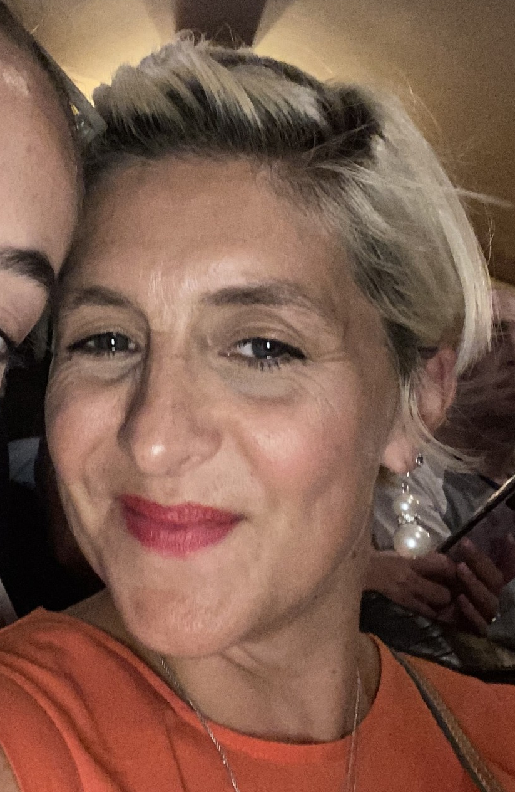

Who’s Who in Reception?
Mrs Wilby
Mrs Eaton
Notes:
Tim

Slide 3


Mission Statement
& Values
Notes:
We have recently reviewed our school mission statement with staff, parents and governors. Feedback indicated that this is still very much who we are and what we strive to do at St Elizabeth’s but that a more child-friendly version was needed. So now our mission is: Be like Jesus. Be your best. Be safe. Be caring.
As a school we celebrate our Franciscan heritage and continue to promote our seven Franciscan Values: joy, forgiveness, faith, respect, service, peace and stewardship. These values underpin everything that we do at school. The aim is that we all practise these values so that they become habitual and, therefore, a virtue. We try to live out each of these values all of the time but in Year 2 we focus especially on ‘Faith’. You can support this through discussing what faith is, reading Bible stories about faith and highlighting individuals who have shown faith in themselves, in others and in God. Ultimately, faith is something that needs to be acted on… it needs to be living!

Slide 4
Communication, Reporting and Assessments
Parents’ Consultation in October and March (Virtual – School Cloud). End of Year School Report.
- Informal communication (end of the school day, appointments
made via the school office, newsletters, class web pages, Tapestry)
- End of year assessment made against the EYFSP – Children aiming to achieve their ELG’s.
Notes:
Tim

Slide 5


The EYFSP document combines
Early Years and Foundation Stage. This creates a national curriculum for 5s and under
7 areas of learning 3 prime areas – Physical development, Personal, social and emotional development and Communication and language. Plus 4 specific areas – Literacy, Mathematics, Understanding of the world, Expressive arts and design, through areas of provision and directed activities
All areas of learning are reflected inside and outdoors.

Slide 6

PSED
Personal, Social and Emotional Development
This is split into 3 areas – Managing Self – Self Regulation – Building Relationships.
So …
Making friends
Learning rules
Learning daily routines
Learning about other
cultures and respect
Understanding boundaries
Making relationships with adults
Developing listening and attention skills

Slide 7
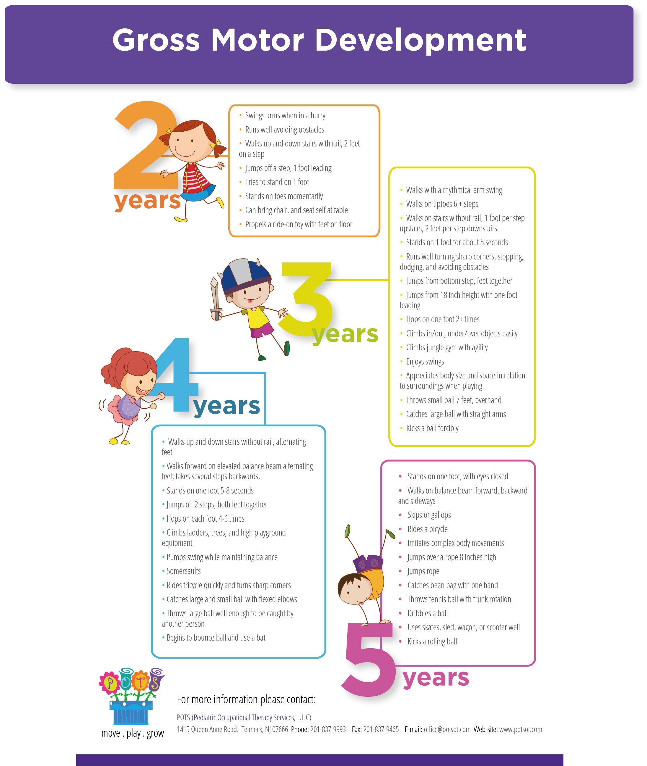
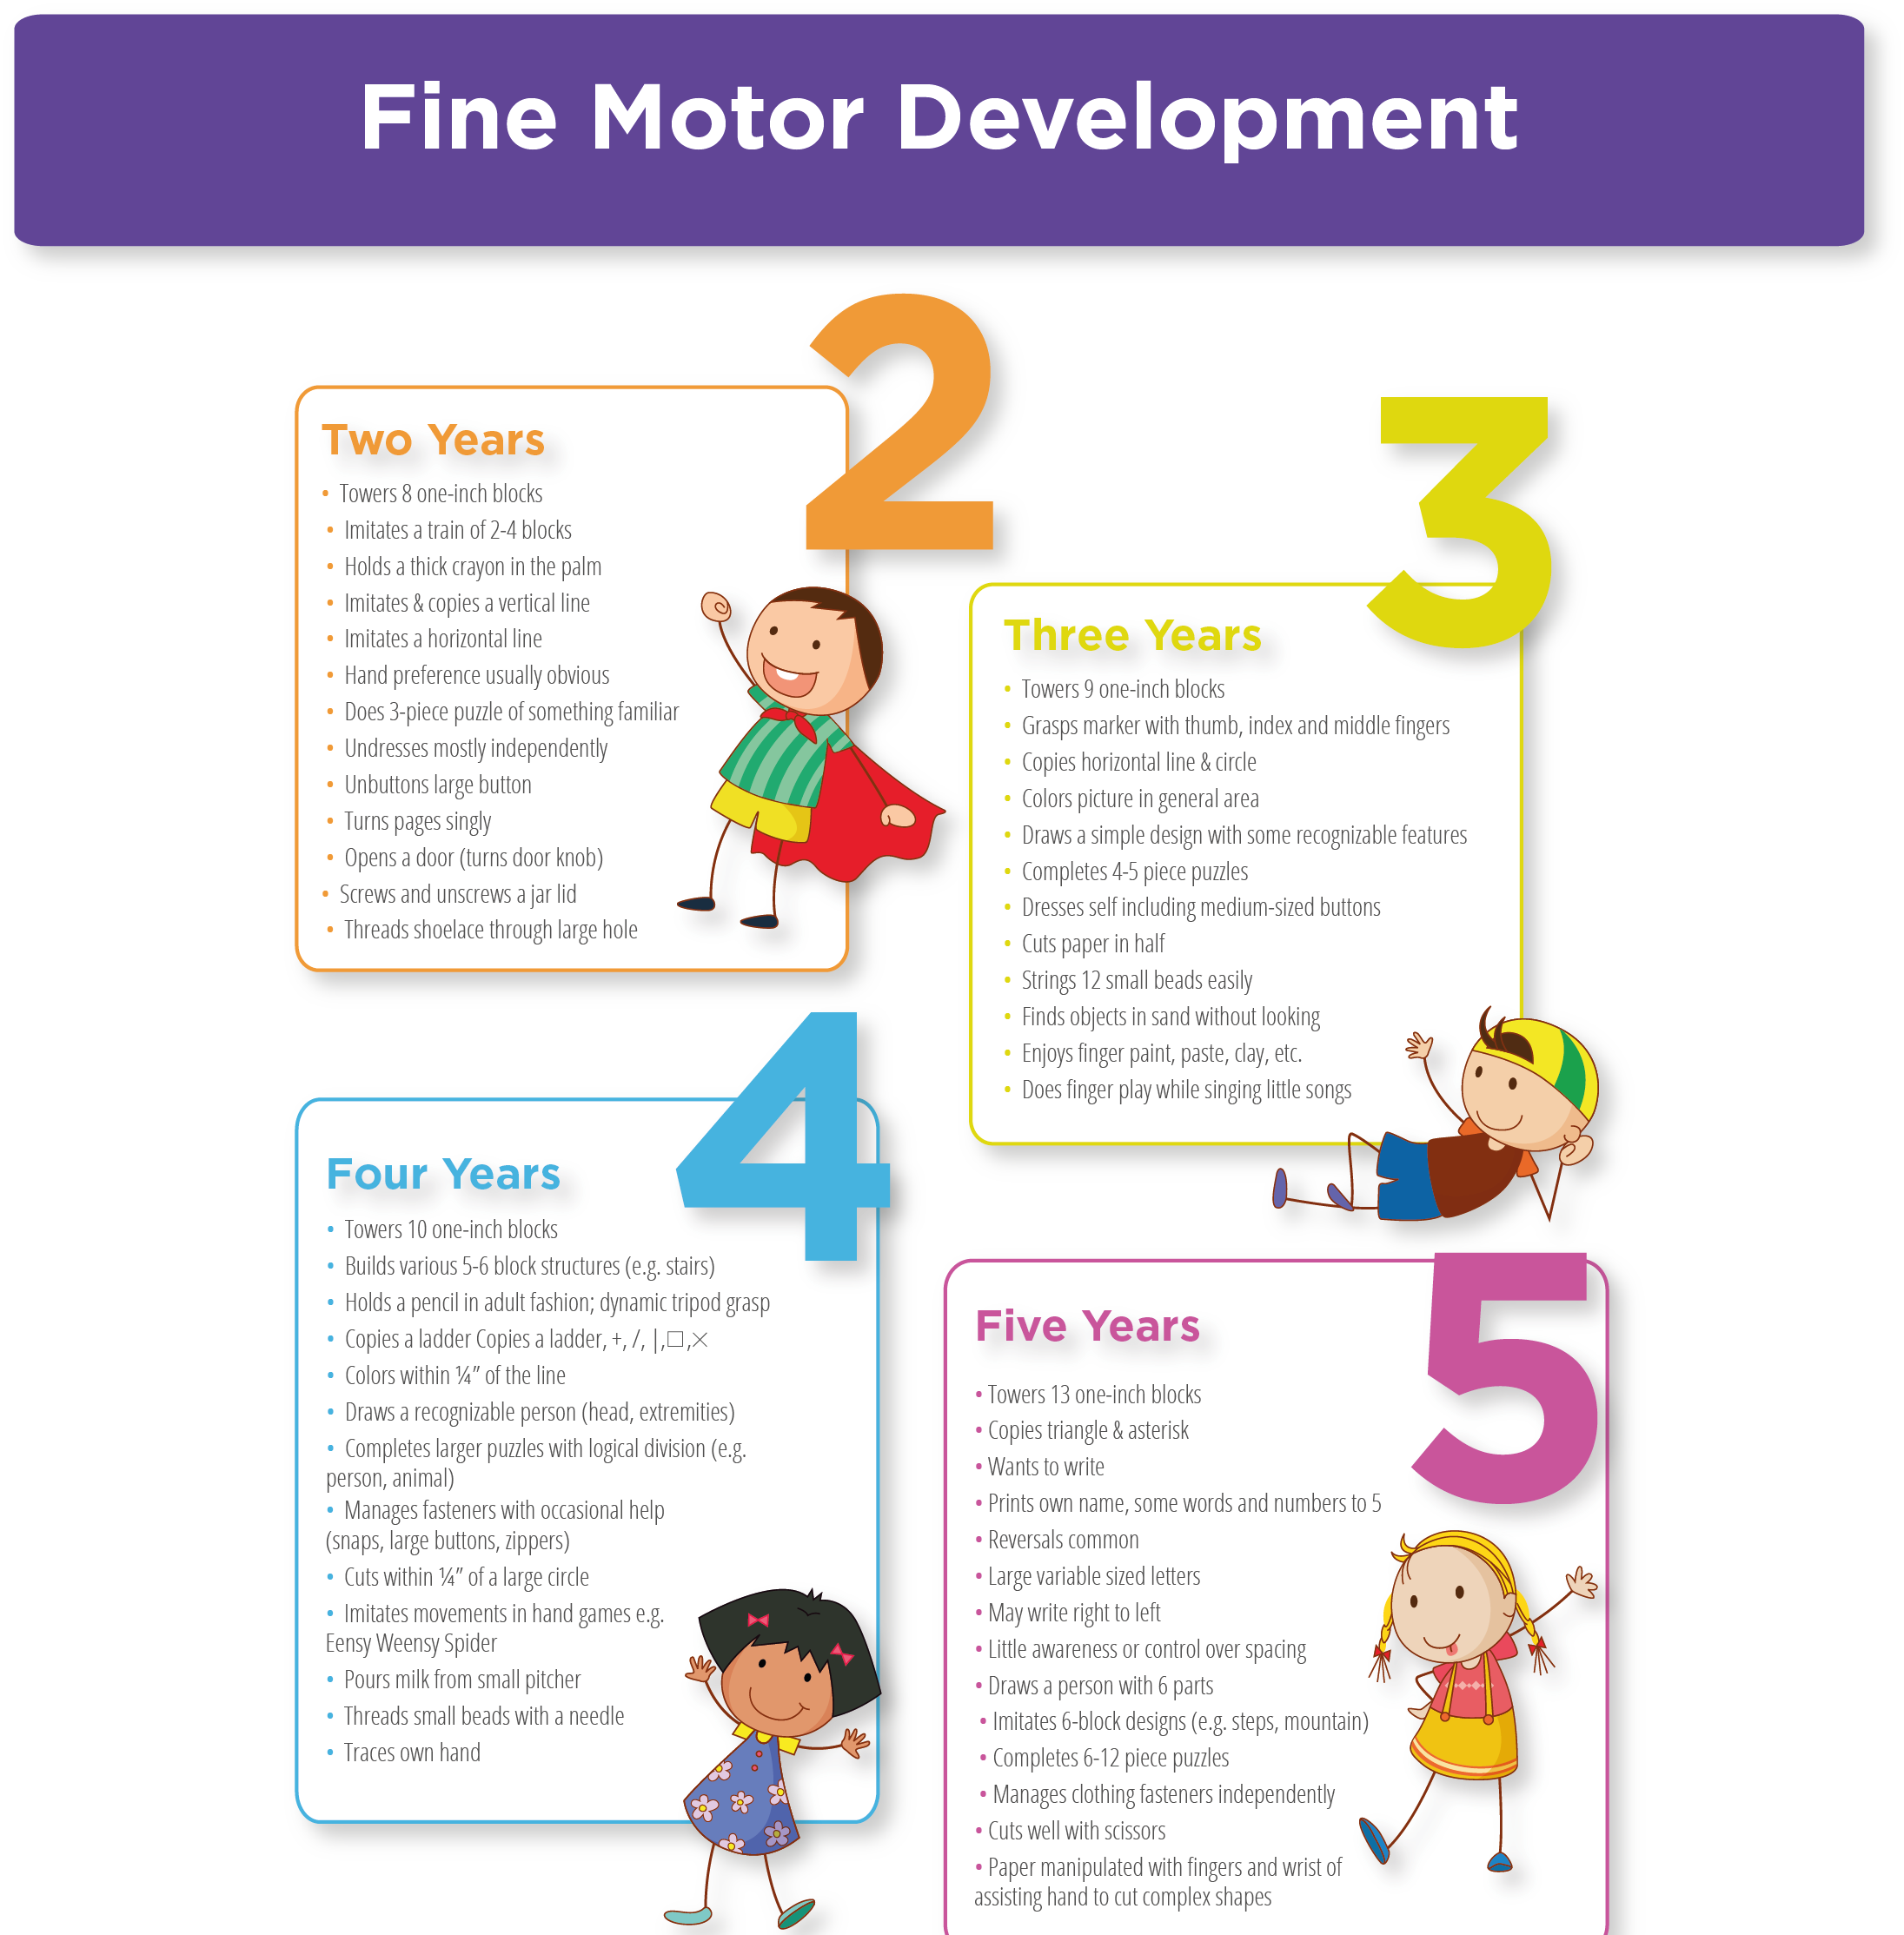
Physical Development
Split into Gross and fine motor skills
So …
Malleable area
Mark making area
Shoes and coats
PE
Dance
Outdoor area
Pencil control
Health and care
Putting on and taking off jumpers' cardigans and coats etc.

Slide 8

Communication and Language
Split into two areas – Listening, attention and understanding – Speaking.
So …
Speaking
Listening
Understanding
Role play
Building up and using new vocabulary

Slide 9

Literacy
Split into three areas – Comprehension – Word Reading – Writing.
So …
Phonics - RWI
Reading
Writing/mark making
Recognising and
writing name

Slide 10
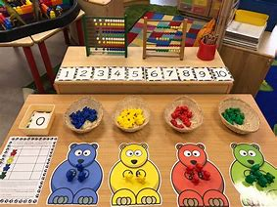
Mathematics
Split into two areas – Number – Numerical patterns.
So …
Counting, subitizing, number bonds
Recognising numbers and what they mean
Composition of numbers
Calculation
Shape
Pattern
Problem solving
Measuring

Slide 11
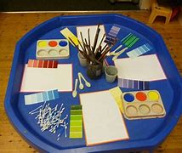
Expressive arts and design
Split into two areas – Creating with materials – Being imaginative and expressive.
So …
Role play
Art
Painting
Drawing
Dance
Music
Singing
Story
Imagination

Slide 12

Understanding the World
Split into three areas – People cultures and community – The natural world – Past and present.
So …
Learning about our own and other cultures, including places and different environments.
Things that happened in the past.
Living things, including important process and changes
Exploring
Investigating
Educational visits
ICT
Constructing
Outdoor area

Slide 13
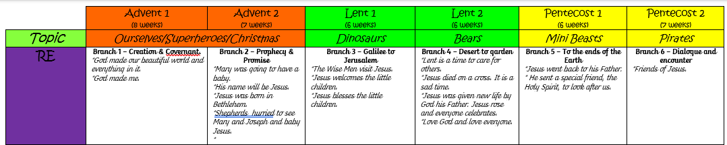
Curriculum Overview

Slide 14
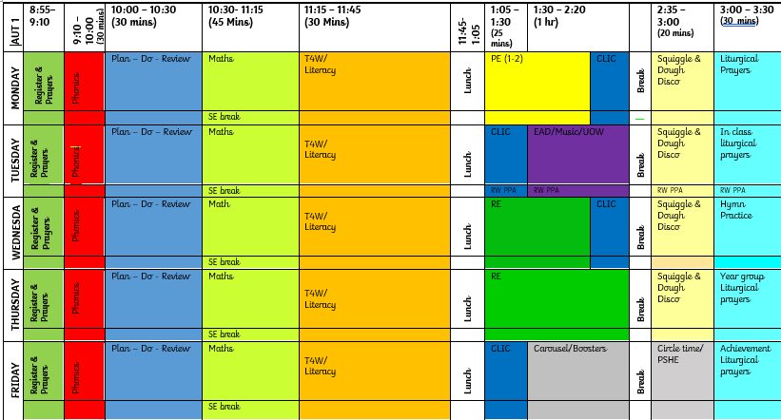
Weekly Timetable

Slide 15

Squiggle while you wiggle
15 minutes a day dough disco and squiggle – builds up children’s finger muscles and wrist muscles to support fine motor control – supports cutting, drawing, writing. (PD and Lit links)
Have a go – if time☺
https://youtu.be/i-IfzeG1aC4
https://www.youtube.com/watch?v=3W5KWnhWwzs

Slide 16
Sharing Success
Using Tapestry:
Share your child’s achievements, no matter how small!
Note down the area (s) of learning, date achieved and what they did.
Post as little or often as you feel the need but please share their achievements.
Parent support and input is VITAL.

Slide 17
Uniform and PE Kit
Smart and ready to learn
Saint Elizabeth’s was founded by the nuns of the Franciscan order in 1936 . Our uniform is gold and brown to reflect the colour of the clothes worn by Saint Francis.
St Elizabeth’s Catholic Primary School uniform identifies us to the wider community, while wearing it instils a sense of belonging and equality amongst the children.
Our school winter uniform is white shirt (polo shirt in KS1, no tie. Collared shirt in KS2, brown and gold tie, brown jumper or cardigan, brown skirt or pinafore dress, black trousers or shorts, black shoes, black, grey, brown or white socks. Any items for hair should remain within these colours of white, black, brown or yellow. Any items for hair should remain within these colours of white, black, brown or yellow.
Our active uniform – which is often referred to as PE kit – is worn to school on PE or sports days. The active uniform is yellow polo shirt, yellow sweatshirt with school logo (optional), unbranded black shorts or black joggers. Trainers or pumps with black, grey or white socks.
Our PE lessons are on the following days:
Advent 1 – Monday
School coats should be either a brown school fleece or black or brown coat.
School bags can be any appropriate bag, however we do request a small size due to storage in school cloakroom areas. School book bags are available to purchase from the school office.
Please ensure that all items of uniform are permanently labelled with your child’s name. This ensures that we can get items back to their rightful owner if they go astray.
Notes:
Ros

Slide 18
Phonics and Early Reading
- Daily teaching of phonics and reading
Review of previously learnt sound
Introduce new sound
Teaching of strategies to decode words containing new sound
Speed read of words containing previously taught sounds
Assessment of reading through the reading of ‘nonsense’ words or place names containing new sound
Spelling of words containing new sounds
Reading of books in pairs with activities to develop fluency, expression, retrieval and inference skills.
Notes:
Tim

Slide 19
Dates for your diary…
27.09.24 – Coffee and cake afternoon to support Macmillan Cancer support.
4.10.24 – Feast Day of St Francis
16.10.24 – World food Day
17.10.24 – Harvest Festival
18.10.24 - Times Table Rock Star Day (Dress Up Like A Rock Star!), Maths Week
W/C 28.10.24 – Half Term
04.11.24 – Back to School
29.11.24 – INSET Day
10.12.24 – Nativity (14:00)
11.12.24 – Nativity (18:30)
20.12.24 – Carols Around the Tree. Break Up for Christmas Holidays
Notes:
Tim

Slide 20
General Information
School day 8:55-3:30 (arrive 8:45) – Now on the main playground.
Breakfast club and after school club available.
Packed lunches clearly labeled with child’s name - no nuts!!
Water bottles & Milk
Ruck sack
Special person
Home toys
Parent helpers – confidentiality agreement.
Tapestry

Slide 21
Notes:
Tim

