Slide 1
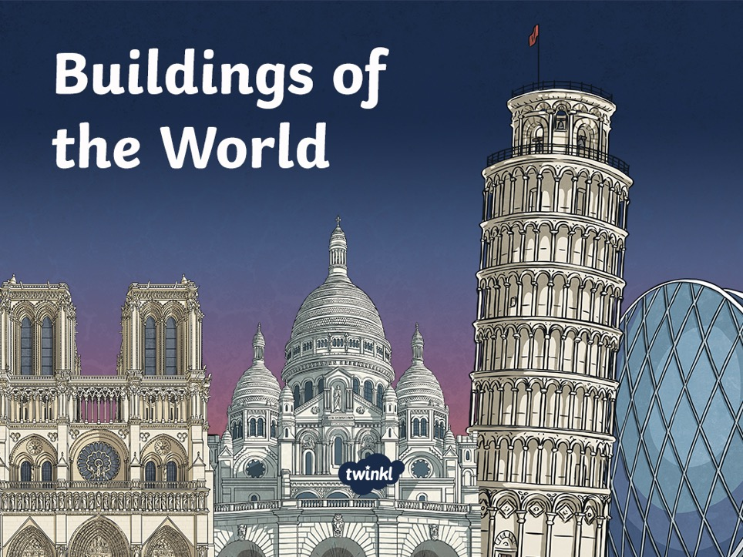
Zaha Hadid vs. A.W.N Pugin

Slide 2
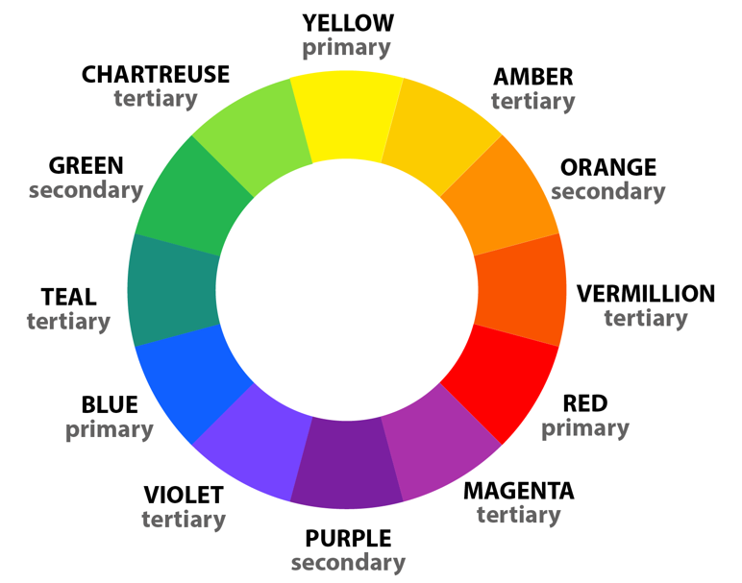
Buildings of the World
Revisit

Slide 3
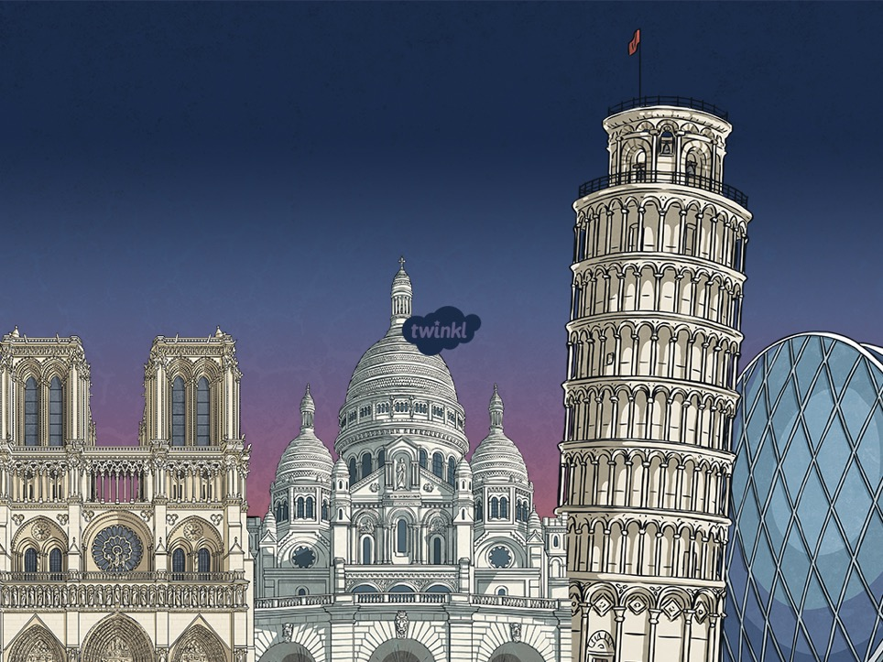


CST Question: Why aren’t architects designing shelters/homes for the homeless or other displaced people (in the UK or abroad)?

Slide 4
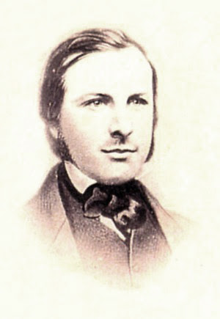
A.W.N Pugin
A.W.N. Pugin (Augustus Welby Northmore Pugin) was a famous architect who lived in the 1800s.
He loved the Gothic style, which was popular in medieval times, and brought it back in a movement called Gothic Revival.
Photos courtesy of National Portrait Gallery, London NPG 113 , Pau Audouard (Wikimedia Commons), Forgemind ArchiMedia (@flickr.com) - granted under creative commons licence - attribution

Slide 5
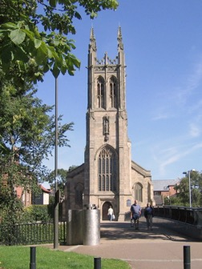
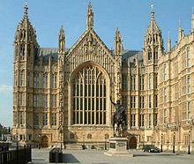
One of his most famous works is the Palace of Westminster (Houses of Parliament) in London, but he also built St. Mary’s Church in Derby.
A.W.N Pugin
Photos courtesy of National Portrait Gallery, London NPG 113 , Pau Audouard (Wikimedia Commons), Forgemind ArchiMedia (@flickr.com) - granted under creative commons licence - attribution

Slide 6
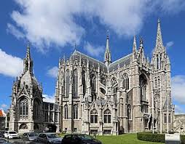
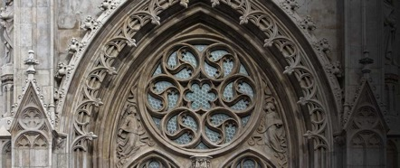
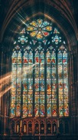
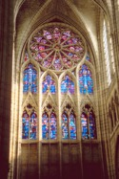
Gothic Revival
Gothic Revival Architecture is a style of building that was inspired by the medieval Gothic style. Its key features are pointed arches, tall spires, stained glass windows, stone, brick and decorative details. Gothic Revival architecture is all about making buildings look grand, beautiful, and full of history!
Photos courtesy of National Portrait Gallery, London NPG 113 , Pau Audouard (Wikimedia Commons), Forgemind ArchiMedia (@flickr.com) - granted under creative commons licence - attribution

Slide 7


Palace of Westminster
London Aquatics Centre
A
B
A. Worked with modern materials like glass, steel and concrete.
B. Created by an award-winning architect.
Photos courtesy of National Portrait Gallery, London NPG 113 , Pau Audouard (Wikimedia Commons), Forgemind ArchiMedia (@flickr.com) - granted under creative commons licence - attribution
Notes:
On the whiteboard, brainstorm quick ideas as the basis for their sentences, i.e. materials, inspiration, shapes, style etc. (Answers are on the planning notes).

