Slide 1

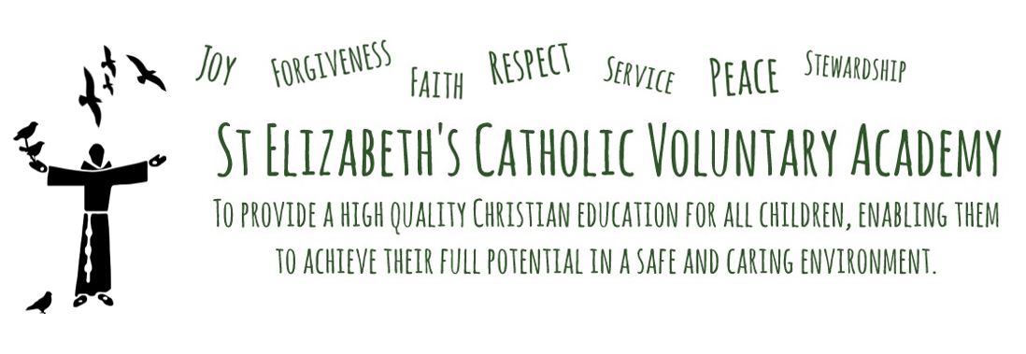




Meet the Teacher
Wednesday 18th September 2024

Slide 2
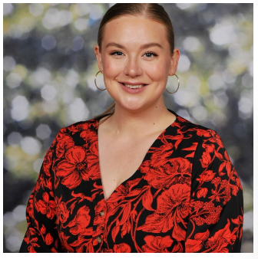
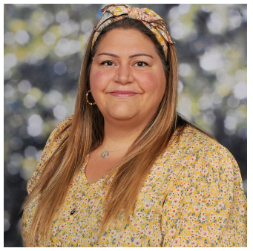
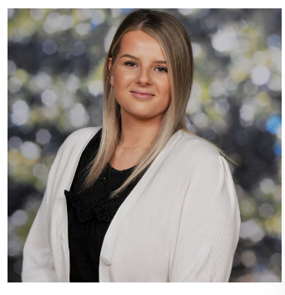

Who’s Who in Year Three?
Miss Evans
Mrs Plastow
Miss Booth
Miss Peynado
Miss Shally

Slide 3
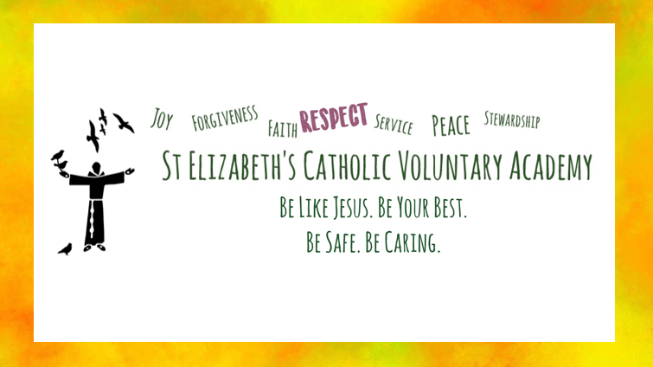

Slide 4
Communication, Reporting and Assessments
Parents’ Consultation Evening –
Wednesday 23rd & Thursday 24th October.
Please look out for details from the school office about booking appointments via School Cloud.
- Informal communication (end of the school day, appointments made via the school office, newsletters, class web pages).
Feedback Policy – How we’ll be giving your children feedback.
Assessments – NFER tests in the autumn and summer term.

Slide 5
Advent 1 Curriculum Overview
RE
Homes and Promises made at Baptism.
Science
Forces and magnets.
Art
Joseph Wright of Derby
History
Local history: why is local history important?
English
List poetry and traditional tales.
Computing
Digital Literacy
Mathematics
Daily arithmetic
Power Maths: Place Value within 1000
Addition and Subtraction
Geography
Describing maps of the world.
Spanish
Phonetics.
Music
Singing and learning to play the recorder.
RSHE
Class rules and British values.
PE
Net and wall & gymnastics.

Slide 6
Advent 2 Curriculum Overview
RE
Promises made at Baptism, Judaism, Visitors.
DT
Bridges
RSHE
tbc
Computing
Information Technology
Music
Singing and learning to play the recorder.
English
Action and non-chronological report.
PE
Basketball and dance.
Mathematics
Daily arithmetic
Power Maths: Addition and Subtraction
Spanish
I am learning Spanish and Musical instruments.
Science
Light

Slide 7
A day in the life of a Year 3 pupil…
8:55-9:05 | Registration and Prayers Morning Task – Daily Arithmetic
09:05 – 09:20 | Spellings
09:20 – 09:45 | Talk 4 Reading
09:45 – 10:00 | Guided Reading
10:00 – 10.45 | Maths
10:45 – 11:00 | Break
11:00 – 12:00 | Talk 4 Writing
12:00 – 13:05 | Lunch
13:05 – 14:20 | RE
14:20 – 14:35 | Break
14:35 – 15:00 | Music
15:00 – 15:30 | Celebration of the Word

Slide 8
Uniform and PE Kit
Smart and ready to learn
Saint Elizabeth’s was founded by the nuns of the Franciscan order in 1936 . Our uniform is gold and brown to reflect the colour of the clothes worn by Saint Francis. St Elizabeth’s Catholic Primary School uniform identifies us to the wider community, while wearing it instils a sense of belonging and equality amongst the children.
Our school winter uniform is white shirt (Collared shirt in KS2), brown and gold tie, brown jumper or cardigan, brown skirt or pinafore dress, black trousers or shorts, black shoes, black, grey, brown or white socks. Any items for hair should remain within these colours of white, black, brown or yellow. Any items for hair should remain within these colours of white, black, brown or yellow.
Our active uniform – which is often referred to as PE kit – is worn to school on PE or sports days. The active uniform is yellow polo shirt, yellow sweatshirt with school logo (optional), unbranded black shorts or black joggers. Trainers or pumps with black, grey or white socks.
Our PE lessons are on the following days:
Advent 1 – Monday and Wednesday
School coats should be either a brown school fleece or black or brown coat.
School bags can be any appropriate bag, however we do request a small size due to storage in school cloakroom areas. School book bags are available to purchase from the school office.
Please ensure that all items of uniform are permanently labelled with your child’s name. This ensures that we can get items back to their rightful owner if they go astray

Slide 9
Year 3 Reading
Reading: The children are delighted with our latest reading venture; Accelerated Reader! This replaces our old home reading scheme, MyBookBlog, after they announced their end this summer. Accelerated Reader is an online programme used to motivate students to increase their reading and vocabulary comprehension. Like MyBookBlog, children are able to complete a quiz after finishing a book and can also access a variety of non-fiction articles to read! A parent introduction letter will be making its way home soon – please keep a look out for this!
Children are given bookmarks, on which they are to write down any words that they are unfamiliar with or have struggled to pronounce. We encourage a minimum of 10 minutes home-reading every day; the more often, the better! This could be independently, to a grown-up or to a sibling.
Your child will also now have their own ‘Reading Journal’, in which they can make notes and drawings about what they have read to help assist them when taking their end of book quiz. This is for both home and school use, so please ensure that it is returned to their school bag once used.
Your child is expected to bring their home-reading book into school once a week, on a set day (which the children are aware of). This is so that teachers and teaching assistants can listen to them read and track their progress. If your child fails to bring their book two weeks in a row, you will receive a letter making you aware of this.

Slide 10
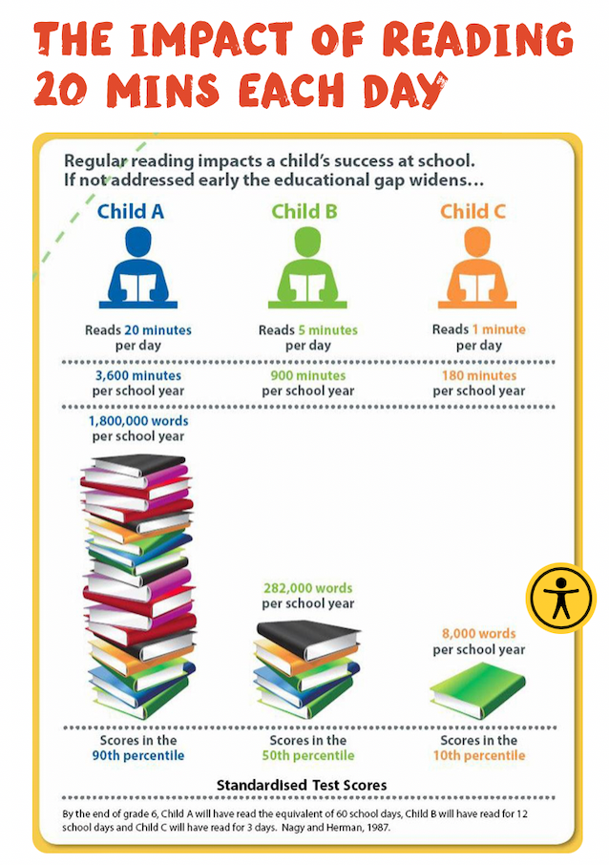
Year 3 Reading Expectations
At least 10 minutes reading everyday – the more the better! This could be reading to an adult or sibling or reading independently.
Children should be recording unfamiliar words onto their bookmark throughout their reading session. Adults are encouraged to record words on these too!
Fostering a love of reading also means that we should be reading to the children regularly too. Audiobooks and Youtube ‘read throughs’ are another great way to hook more reluctant readers! Help to develop a love of reading through exposure to a variety of books, comics, graphic novels, recipes etc.

Slide 11
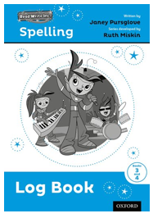
Spelling
Our KS2 spelling scheme – Read, Write, Inc. Spelling, continues on from our KS1 phonics scheme to allow for cohesive and consistent progression and development.
Assessment throughout a unit is ongoing and children will be logging spellings that they find difficult in their ‘Spelling Logs’.
These words will be personalised to each child, as the children choose the words they wish to ‘log’, based on which words they have found difficult throughout the week.
Therefore there is no ‘set’ spelling list each week. Due to the 3-day cycle of the scheme, the day of the week that these words will be recorded will change.
These words are then tested in partners (in a low-stakes manner) at the start of the following unit.
You can help support your child by practising the words in your child’s spelling log each night at home, and by revisiting words learnt in previous weeks.

Slide 12


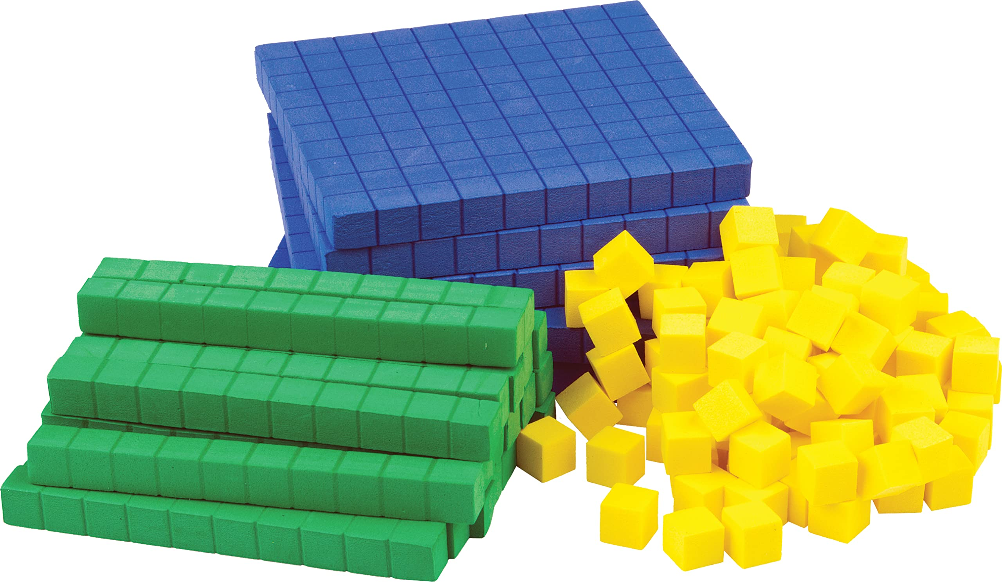
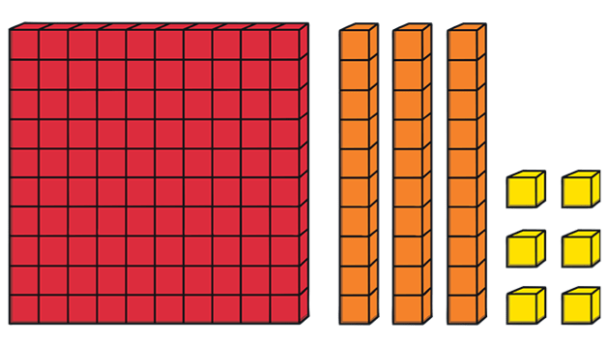
Mathematics
The lessons are broken down into different section; Discover – pair working to answer a mathematical question based in a relatable situation; Share – whole class teacher lead where we look at how the answer can be achieved; Think Together – I do, We do, You do. We work out the questions together using different approaches; Practice – Independent practice (the work in their books).
We support children's learning through concrete, pictorial and abstract, to ensure that the children develop a deeper understanding of what they are learning. The children then build on these approaches, developing and embedding skills over time, which can then be used to reason and solve problems.
136
Concrete
Pictorial
Abstract
Notes:
We follow the Power Maths scheme which is a UK curriculum mastery programme.
For each unit of work Power Maths has identified common misconceptions, tasks to strengthen mastery and to go deeper which challenge children further.
We support children's learning through concrete, pictorial and abstract, to ensure that the children develop a deeper understanding of what they are learning. The children then build on these approaches, developing and embedding skills over time, which can then be used to reason and solve problems.
We use mistakes and misconceptions as an essential part of learning and provide challenge through rich sophisticated problems.
Work is live marked by teachers and T.A.s so that we can give on the spot interventions.
End of unit tests help us to track progress and develop and challenge where appropriate.
Every classroom has an appropriate Maths Working Wall. Working walls are interactive displays that are designed to reinforce and consolidate children’s knowledge and understanding through practical applications in order to aid children in their learning.

Slide 13
Dates for your diary…
Dates For Your Diary
27.09.24 | 14:30 – 15:30 | Macmillan Coffee Afternoon You are invited to join other parents and members of the school community to nibble, natter and raise funds for the amazing work done by Macmillan Cancer Support. The children are invited to bring in cakes on this day to be sold and money to spend at the cake sale. We’ll be holding a raffle too!
07.10.24 | Ongoing | Harvest Appeal Launches Please begin to bring in donations for our Harvest Appeal. Donations will be sent to Hope for Belper Food and Community Hub. More information to follow.
17.10.24 | 15:00 – 15:30 | Harvest Celebration You are invited to join us in the school hall for our Harvest celebrations. This will be led by our school Chaplaincy Team but all of the classes will be joining in with different elements.
18.10.24 | All Day | Times Table Rock Star Day We will be holding our annual relaunch of TT Rock stars. The children are invited to dress up as ‘rock stars’ on this day and we will be doing lots of maths and counting activities in class. Children should bring their PE kit to change into and ensure they have appropriate footwear.
23.10.24 | 16:50 – 18:00 | Parents’ Consultation Evening Please look out for details from the school office about booking appointments via School Cloud.
24.10.24 | 16:50 – 18:00 | Parents’ Consultation Evening Please look out for details from the school office about booking appointments via School Cloud.
W.C.28.10.24 | HALF TERM

Slide 14
Other helpful information
Break time:
At break times our pupils are only allowed to consume fruit or vegetables. It will also help us to limit litter & control the environment to make it safe for pupils with a nut allergy.
Water is encouraged at breaks as well as in the classroom. This is to ensure that pupils return to the classroom prepared & refreshed for learning.
Homework:
Children have been given a homework folder. They will use this throughout KS2 and hand it back in at the end of Year 6.
Children will be given one week to complete any homework set.

Slide 15
