Slide 1
Meet the Teacher Class Video :Tuesday 14th September 2021 Teams Meeting: Wednesday 15th September 2021

Slide 2
Who’s Who in Year Three? Mrs Parry Mrs Lawler Mrs Plastow
Notes:
Tim

Slide 3
Notes:
Tim

Slide 4
Communication, Reporting and Assessments
Parents’ Consultation in November and March (Virtual – School Cloud)
- End of Year School Report and opportunity for consultation
- Informal communication (end of the school day, appointments made via the school office, newsletters, class web pages)
- Feedback Policy – Children are given feedback about
their work during a lesson and at the start of the next
lesson, strengths and areas for improvement are reviewed.
Notes:
Tim

Slide 5
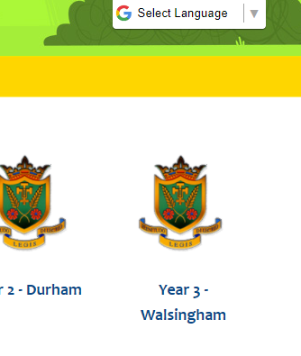
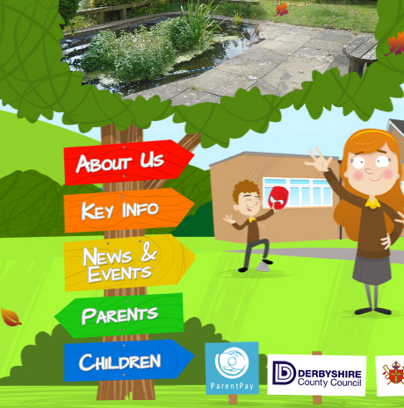
What are we learning about in Year 3?
Please visit our class webpage which has all the information you need!
Notes:
Ros

Slide 6
Autumn 1 Curriculum Overview
Geography
DESCRIBING MAPS OF THE WORLD
Advent Term 1
RE
HOMES and PROMISES
Art
JOSEPH WRIGHT OF DERBY
English
POETRY and TRADITIONAL TALE
Computing
CODING
Science
PLANTS
Mathematics
Big Maths: CLIC
Power Maths: Numbers to 1000 PLACE VALUE
ADDITION & SUBTRACTION
Music
CHARANGA
PE
OUTSIDE GAMES
Notes:
Tim
Science: Growing Up and Staying Healthy - animals, including humans, have offspring which grow into adults, describe the basic needs of animals, including humans, importance of exercise, eating the right types of food, and hygiene.
History: ‘Nursing: Lives of Significant Individuals’
Comparing nursing from different periods. How has Florence Nightingale/Mary Seacole/Edith Cavell made the world a better place today?
Art: Artist Study: Giuseppe Arcimboldo.
(Drawing self-portraits using pencil, charcoal, chalk, pastels, and collage)
DT: ‘Tooty, Fruity Salads’
A healthy Fruit Salad
(Cooking and Nutrition)
Computing: Questioning – linked to Fruit Salads. Online Safety – importance of covering this, more time spent online etc.
PE: Fundamental Football and coach – dance, gymnastics, athletic skills, yoga bugs too

Slide 7
Autumn 2 Curriculum Overview
History
LOCAL HISTORY
RE
JUDAISM and VISITORS
Advent Term
2
DT
BRIDGES
English
INSTRUCTIONAL TEXTS & DIARY ENTRY
Computing
ONLINE SAFETY &
SPREADSHEETS
Mathematics
Big Maths: CLIC
Power Maths:
ADDITION & SUBTRACTION
MULTIPLICATION & DIVISION
Music
CHARANGA & INTRODUCING PLAYING THE RECORDER
PE
OUTSIDE GAMES
Notes:
Ros

Slide 8
A typical day in the life of a Year 3 pupil…
8.55 – 09:10 | Prayers/Collective Worship, Register, Morning Task
09:10 – 09:30 | Small group guided reading
09:30 – 10.45 | English – Talk for Writing
10:45 – 11.00 | Morning Break
11.00 – 11:45 | CLIC (mental maths) and Maths
11:45 – 12:30 | Lunch Time
12:30 – 12.50 | Whole Class Talk for Reading
12.50 – 2.00 | Science or R.E. or P.E. or History / Geography or Computing etc
2.00 – 2.15 | Break
2.15 – 3.00 | Music or P.E. or P.S.H.E. etc
3.00 – 3.15 | Flash cards on the class interactive board to remind us of our learning Story time
Notes:
Tim

Slide 9
Uniform and PE Kit
- Smart, clean and ready to learn
- Clothing labelled
- Tuesdays and Wednesdays children come in P.E. kit
Snacks and Pencil Cases
Fresh or dried fruit. Veggies. Children can have snacks at either play
Water bottles
- Sensible pencil case for children’s tray (pencil, rubber, ruler)
Notes:
Tim

Slide 10
Year 3 Reading Expectations
- At least 10 minutes reading to an adult, everyday, of MyBookBlog home reader. - Being read to by adults regularly to develop a love of reading through books at home.
- Record unfamiliar words on a bookmark and revisit daily.
- Reread books to develop fluency, pace, expression and comprehension.
- Complete all activities and questions on MyBookBlog.
Notes:
Tim

Slide 11
Dates for your diary…
14.09.21 – We have started collecting donations for Harvest.
24.09.21 – TT Rockstars relaunch day – dress like a rock star!
01.10.21 – Harvest Festival Liturgy
09.11.21 – Parents’ Evening (School Cloud)
10.11.21 – Parents’ Evening (School Cloud)
Notes:
Tim

Slide 12
Notes:
Tim

